Slide 1
Create
Read
Update
Delete
Michal Špaček https://www.michalspacek.cz

Slide 2
Recap
New stuff

Slide 3
Recap
Databases, tables, columns, what the...
New stuff
Adminer
Queries
(C) INSERT
(R) SELECT
(U) UPDATE
(D) DELETE
Database + PHP = ❤

Slide 4
Recap – Hardwares db servers (boxes)
Box 1
Box 2
Box 3
Box 4

Slide 5
Recap – Software db servers
MySQL 1
PostgreSQL
MSSQL
XYZ
Oracle
MySQL
2
MySQL
ABC

Slide 6
Recap – Databases (schemas)
A
B
Proj1
P6
Proj2
Proj3
Shop
P3
ABC

Slide 7
Recap – Tables
A
B
Users
Addresses
Orders
Products
Stuff
MySQL 1

Slide 8
Recap – Rows and Columns
A
First | Last | City | Country
John | Foo | NY | US
M | S | Praha | CZ
Users
Orders
Stuff

Slide 9
Database management tool
phpMyAdmin https://www.phpmyadmin.net/
Adminer https://www.adminer.org/

Slide 10
MySQL
SQL – Structured Query Language
Compatible MySQL forks
MariaDB
Percona
AWS Aurora
Other well-known servers
PostgreSQL
Microsoft SQL server
Oracle Database

Slide 11
MySQL credentials (XAMPP default)
Server: localhost (or 127.0.0.1) User: root
Password: <none> Or: root Or: rootroot
(Database: …)

Slide 12
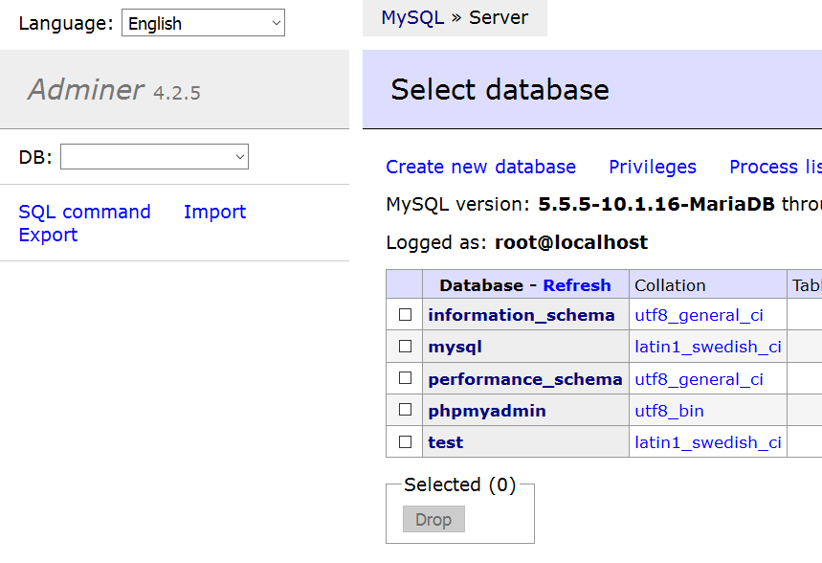

Slide 13
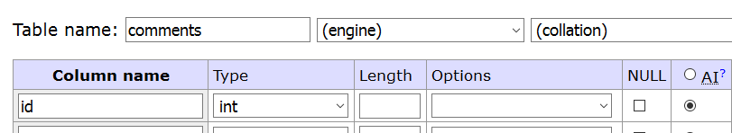
Have column id AUTOINCREMENT in every table

Slide 14
Data types
Numbers INT
Strings VARCHAR(maxlength)
Dates DATE or DATETIME
NULL = nothing, not even empty
https://dev.mysql.com/doc/en/data-types.html

Slide 15
Create – INSERT
INSERT INTO table (name, city) VALUES ('John', 'Prague');
INSERT INTO table (name, city) VALUES ('Jack', 'NYC');
INSERT INTO table (name, price) VALUES ('submarine', 123456789);
INSERT INTO table (name, price) VALUES ('pizza', 1000000);

Slide 16
Read – SELECT
SELECT name, city FROM table;
(SELECT * FROM table;)
SELECT name, city FROM table WHERE name = 'Jack';
SELECT name FROM table WHERE name = 'Jack' AND city = 'NYC';

Slide 17
In PHP – PDO, PHP Data Objects – INSERT
// If not connected already $pdo = new PDO('mysql:host=localhost;dbname=...;charset=utf8', $user, $pw);
$stmt = $pdo->prepare('INSERT INTO … (…, …) VALUES (?, ?)');
$stmt->execute(array($_POST['name'], $_POST['city']));

